Slide 1
LOS ANGELES
REAL ESTATE
Katherine
James
Rebecca
Divya

Slide 2
QUESTION
Do Regular or Airbnb properties have more earning potential?

Slide 3
DATA SOURCES
01
02
MASHVISOR
CENSUS - POPULATION
API which was used to pull Airbnb and regular property data
Population by neighborhood
James

Slide 4
REGULAR PROPERTIES
Neighborhood Name
Price
Latitude
Longitude
Property Type
AIRBNB
Neighborhood Name
Price
Latitude
Longitude
Property Type

Slide 5
ASSUMPTIONS & LIMITATIONS
AirBnb occupancy is 18 nights a month
Randomly selected 10 neighborhoods present in both datasets
Property types grouped into 4 categories
Limited to 100 api calls/user account
Api documentation did not always match data retrieved (ROI)

Slide 6
NEIGHBORHOODS
SILVER
LAKE
PACIFIC
PALISADES
DOWNTOWN
ENCINO
HOLLYWOOD
VENICE
MAR
VISTA
SOUTH
LA
STUDIO
CITY
WESTWOOD

Slide 7
DATA CLEANING I
EXTRACTION
REMOVAL & CLEANING
STANDARDIZATION
Extracted Airbnb dataset and regular property dataset from API.
Removed unnecessary columns from Airbnb and regular data.
Determined appropriate monthly occupancy for Airbnb to be 18 days/month.

Slide 8
DATA CLEANING II
PARSING DATA
MERGE DATA
ANALYSIS
Parsed out data from columns with contained several pieces of data.
Merged data on Neighborhood name.
Performed comparative analysis on data.

Slide 9
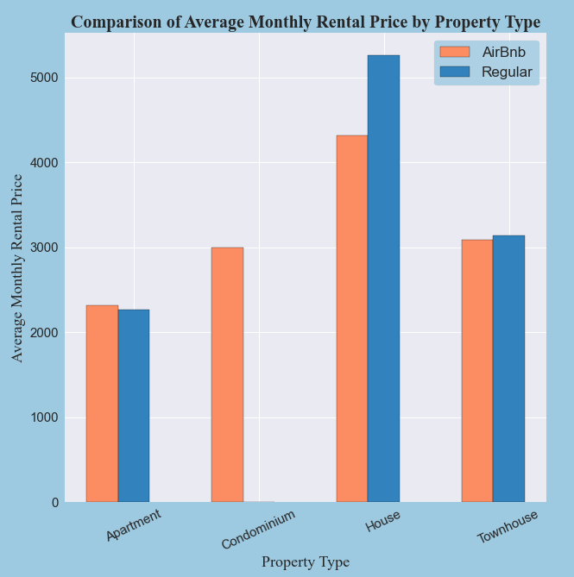
Average Price by Property Type

Slide 10
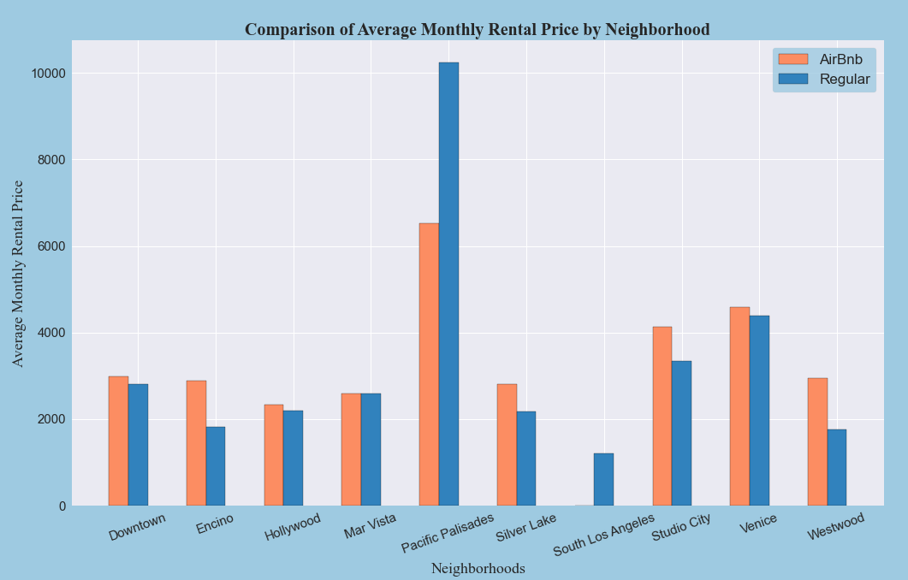
Highest Rental Price - Pacific Palisades

Slide 11
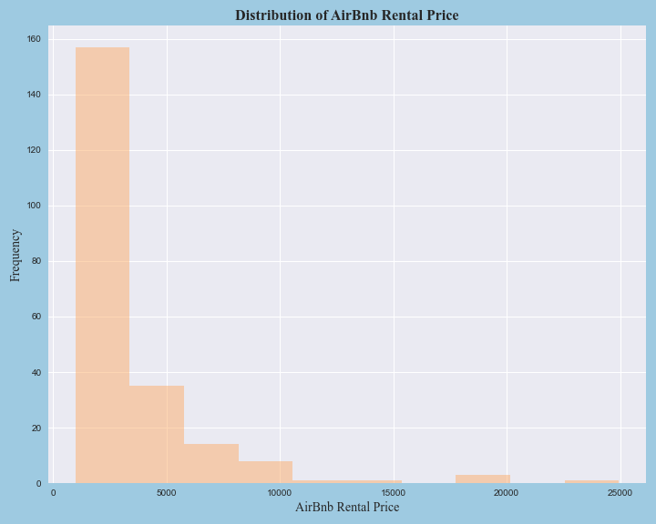
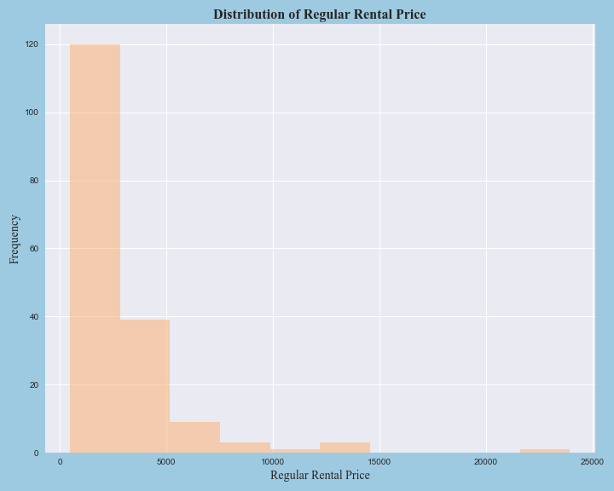
Property Price Distributions

Slide 12
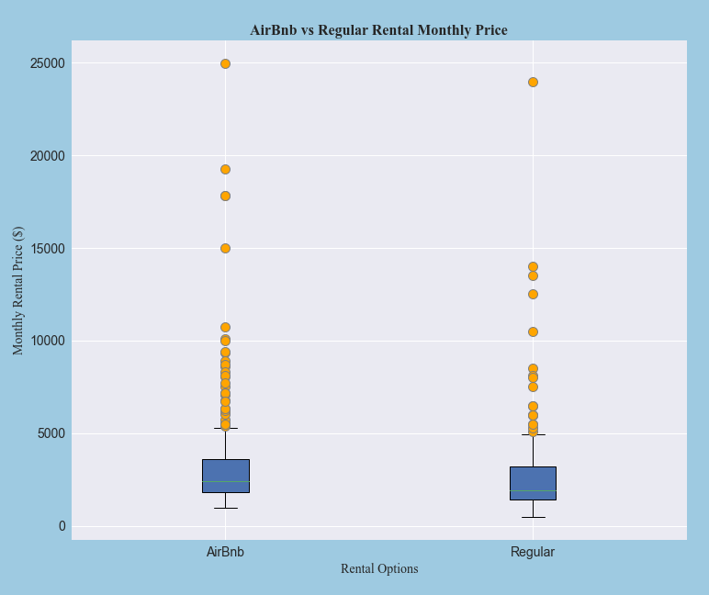
Rental Options Boxplots

Slide 13
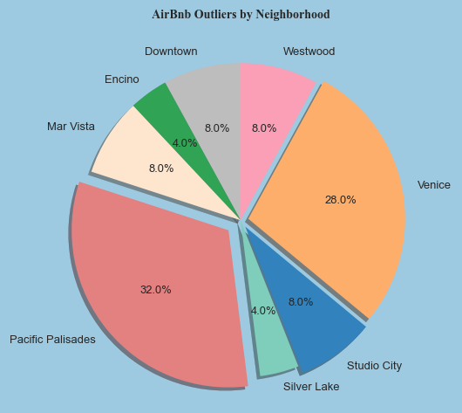
Airbnb Outliers by Neighborhood

Slide 14
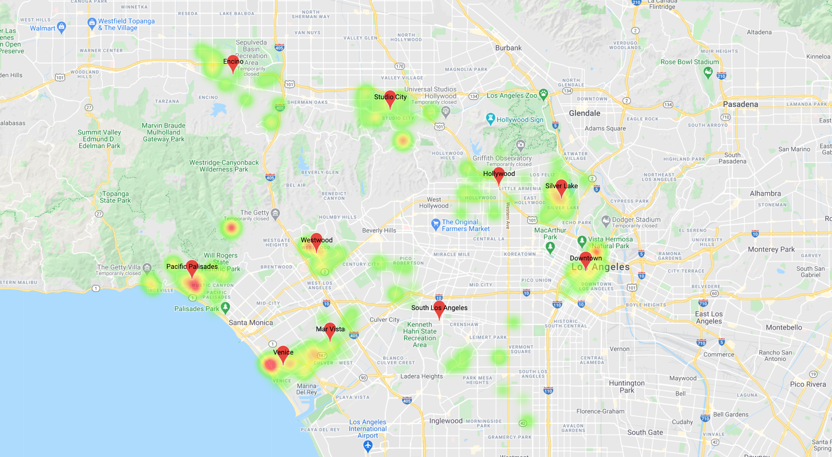
Airbnb Heat Map by Price

Slide 15
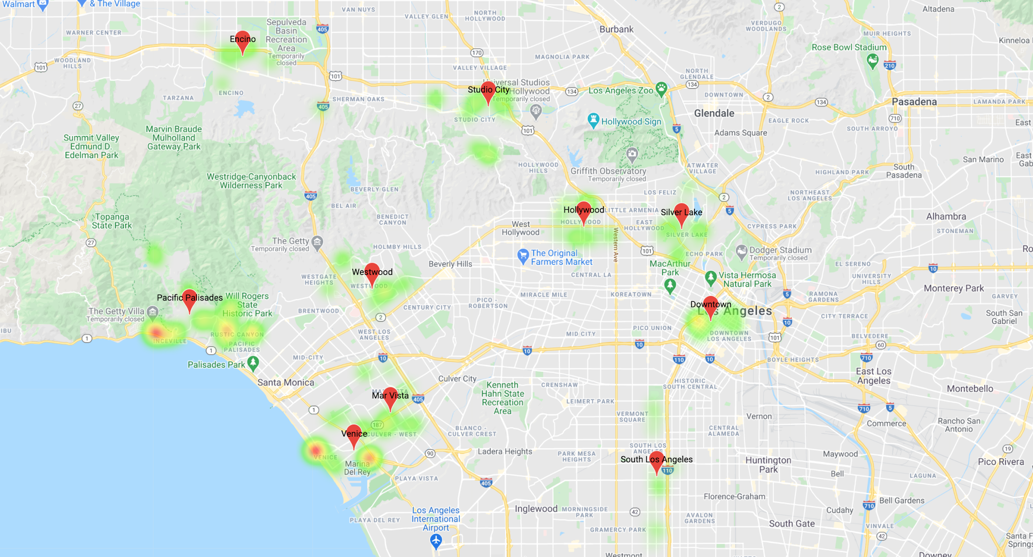
Regular Property Heat Map by Price

Slide 16
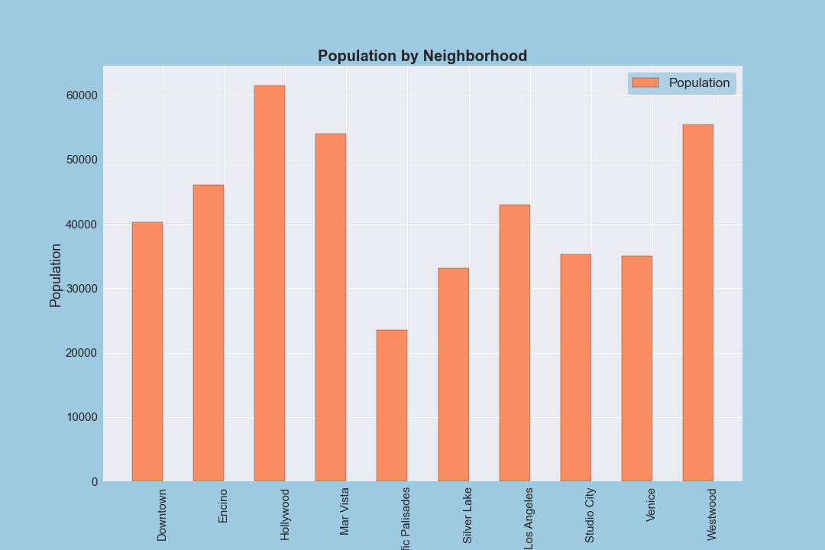
Neighborhood Populations
Highest Population: Hollywood
Lowest Population: Pacific Palisades
Key Observation: Properties in highly populated neighborhoods of LA tend to be listed at lower prices for traditional rentals as well as for Airbnb
Divya

Slide 17
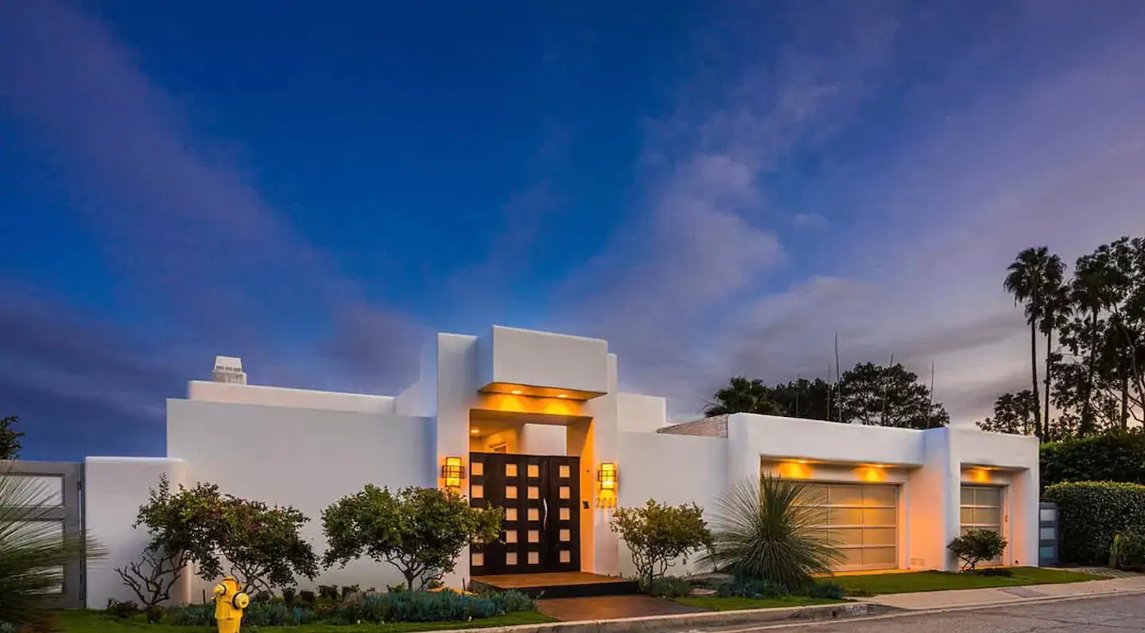
Most Expensive Airbnbs
Pacific Palisades - $24,948/month

Slide 18
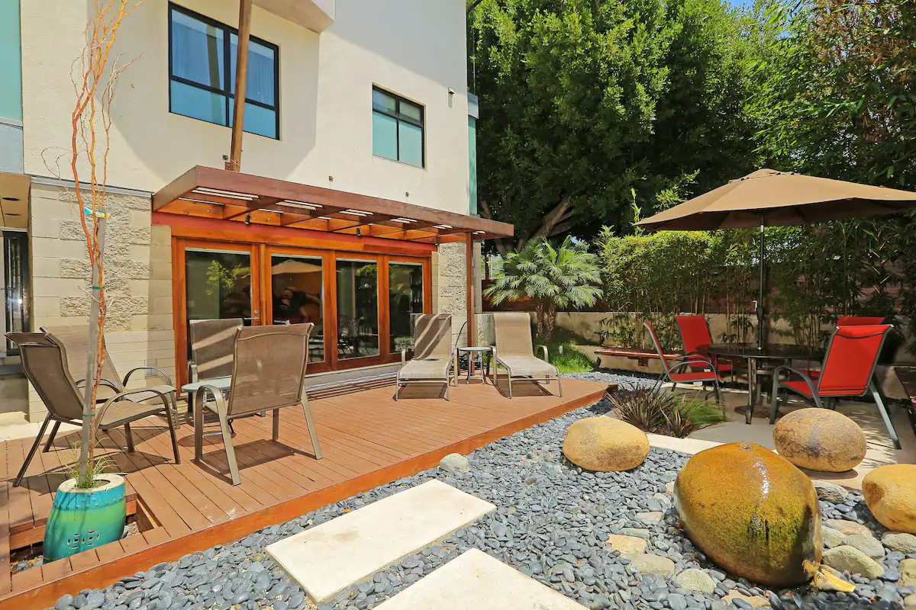
Most Expensive Airbnbs
Venice - $8,694/month

Slide 19
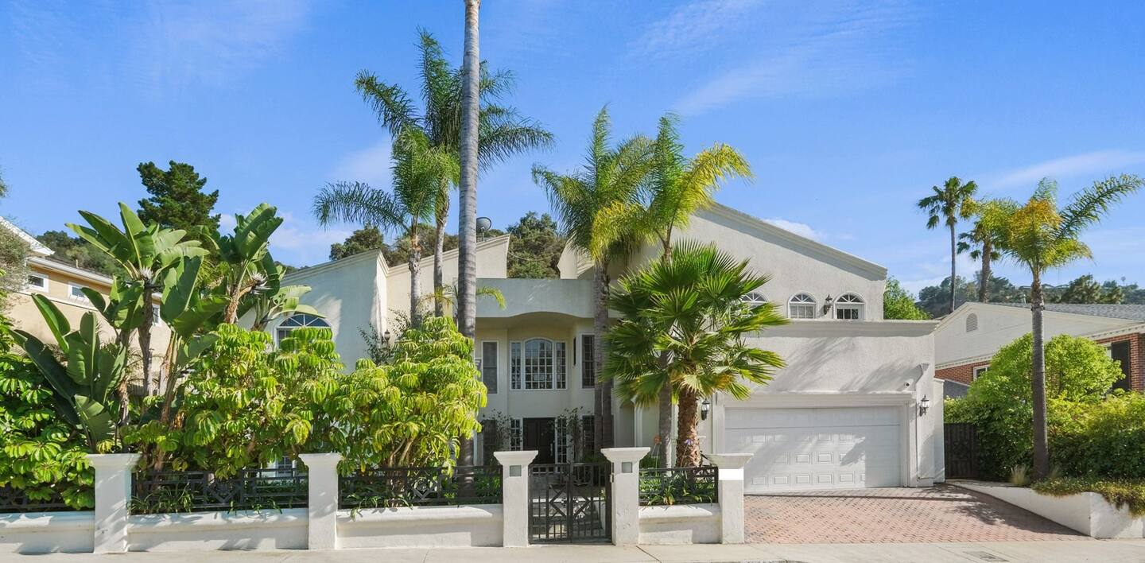
Most Expensive Airbnbs
Studio City - $19,260/month

Slide 20
IMPLICATIONS & FINDINGS
Airbnb properties have higher rental prices than regular properties.
Regular properties have higher earning potential in higher-end neighborhoods.

Slide 21
Extensions to Analysis
Gentrification analysis
Crime data by neighborhood
Proximity to businesses/schools
State of economy
Return on Investment (ROI)

